Slide 1


3DINV
3D Indoor Navigation Viewer

Slide 2
INDEX
INDEX
Motivation and Goal
IndoorGML & Cesium
Project Design
Method
Implementation
Future Research Plan
Conclusion

Slide 3
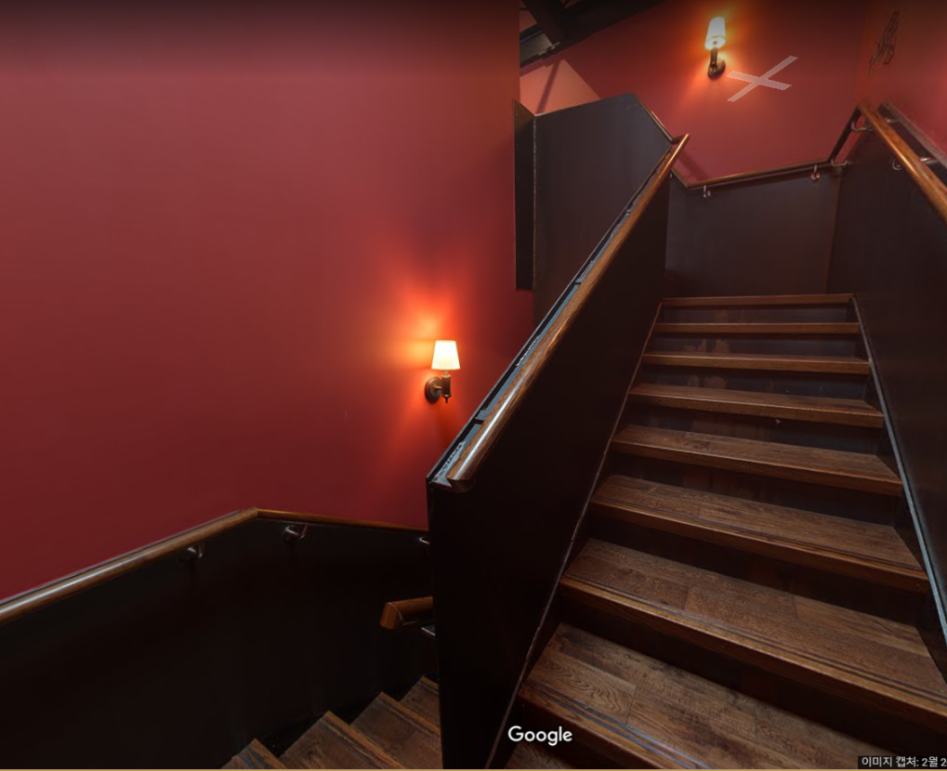
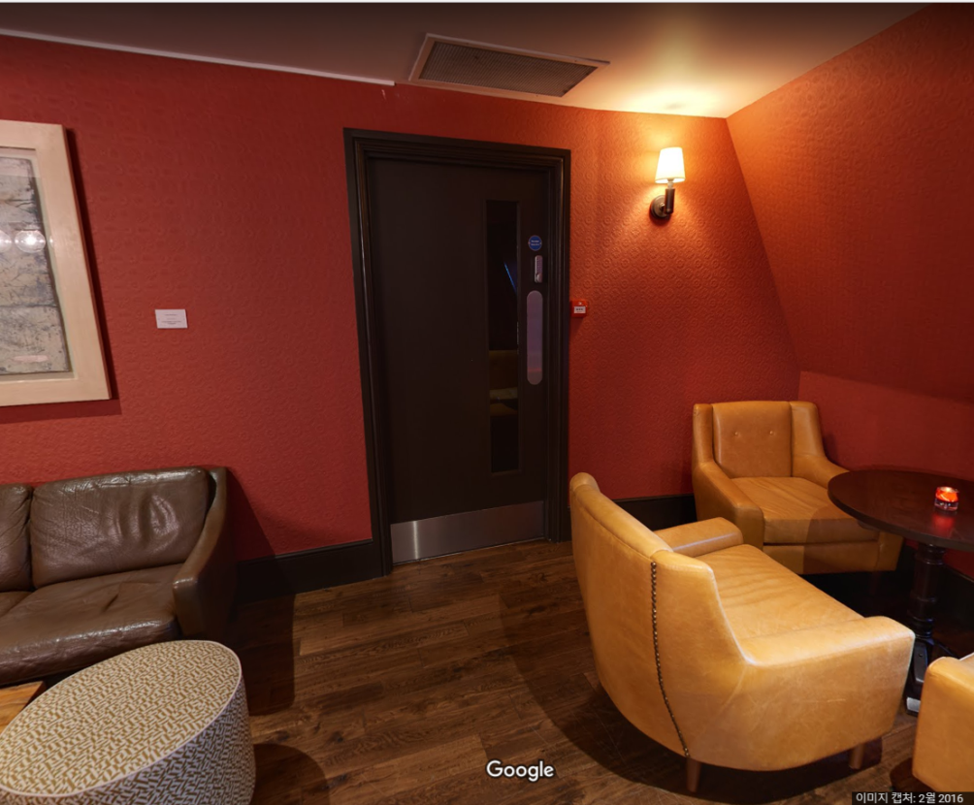
MOTIVATION AND GOAL
Motivation
and
Goal
1. No collision detection
Can’t detect collision &
Inadequate movement
Picturehouse Central in Google Maps

Slide 4
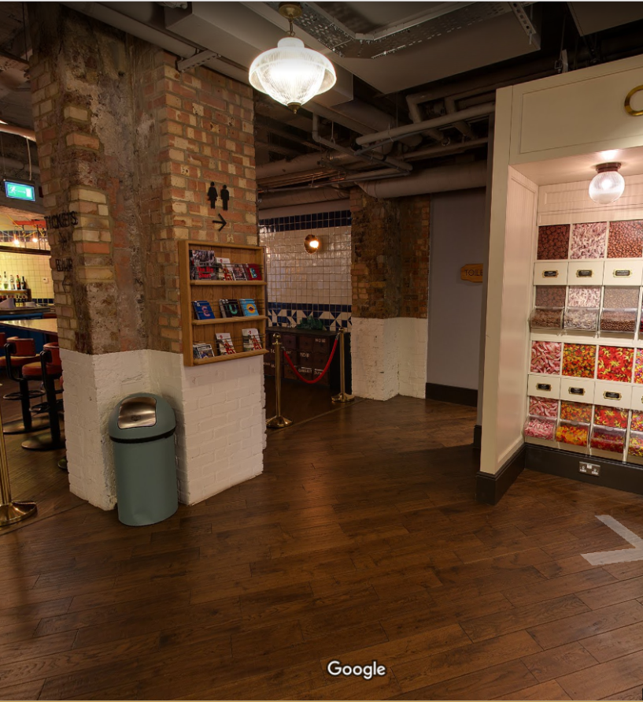
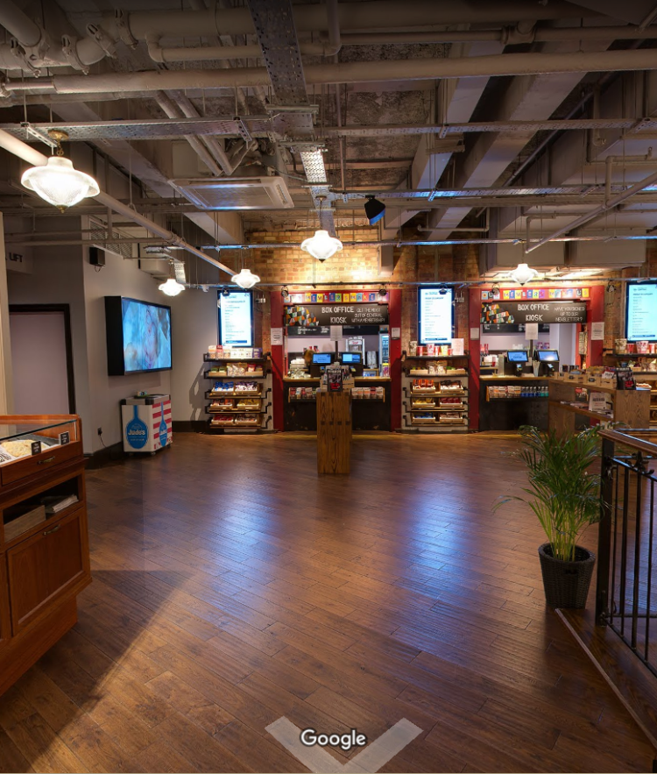
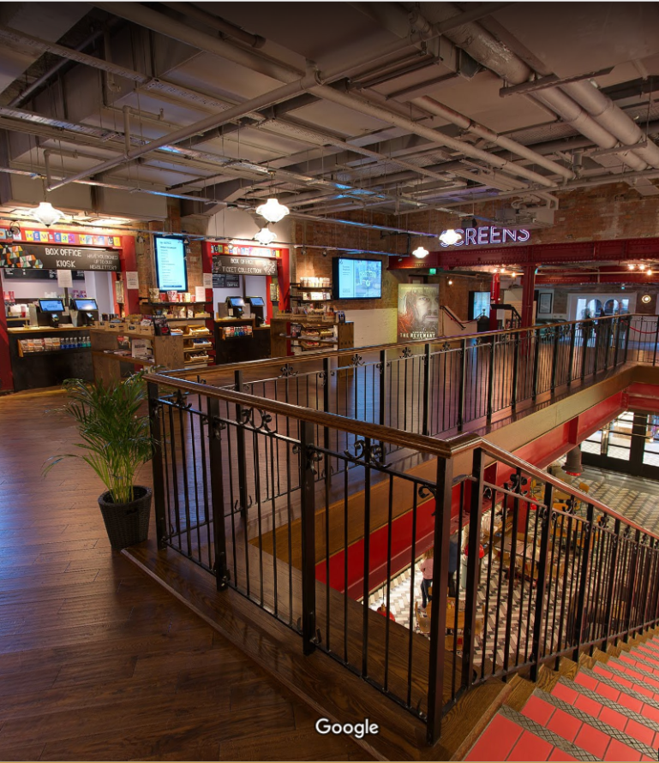
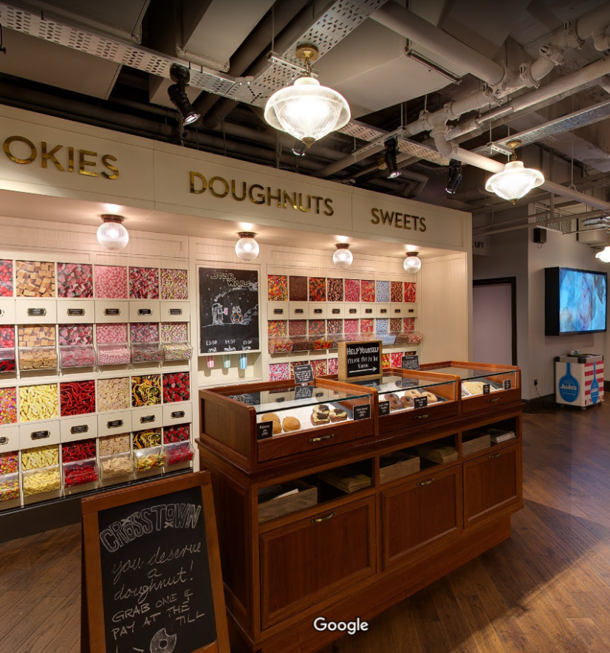
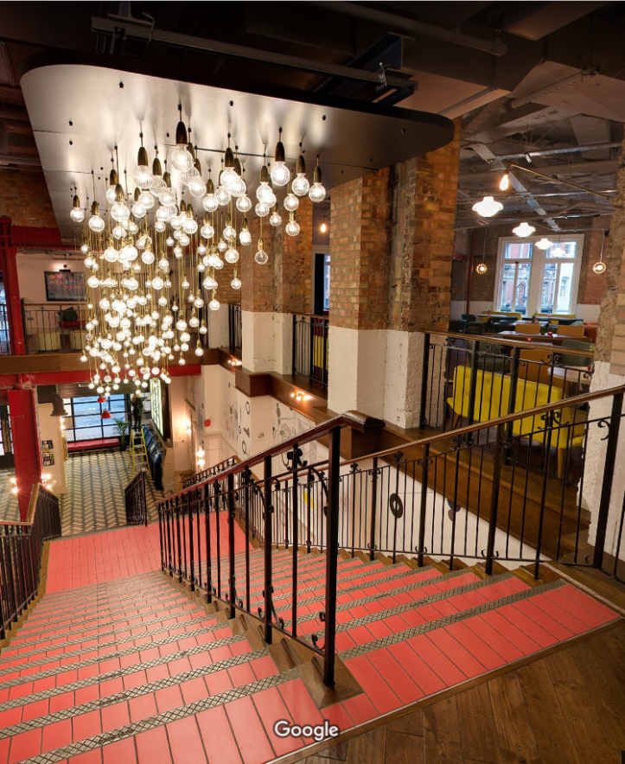
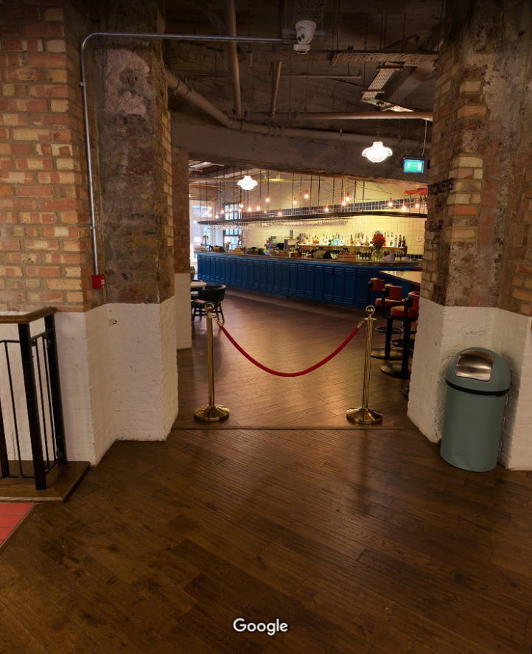
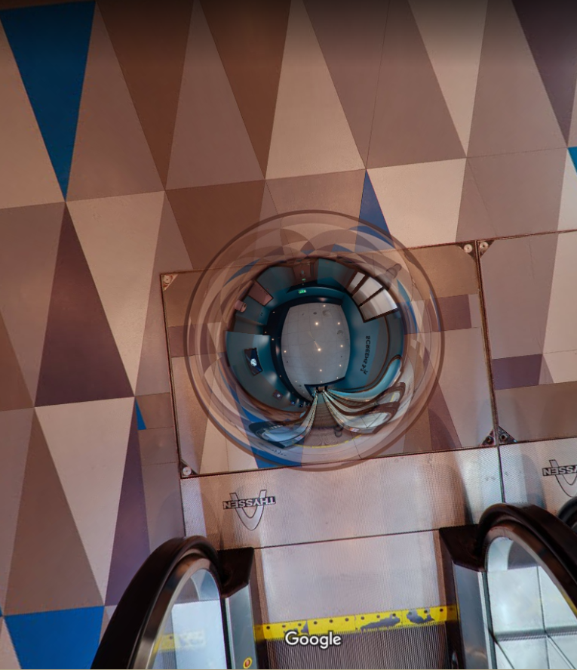
MOTIVATION AND GOAL
Motivation
and
Goal
2. Taking space individually
Distorted location of camera
The camera is fixed and
Take a 360 degree picture
You must stay at each point
and can look around

Slide 5
MOTIVATION AND GOAL
Motivation
and
Goal
3DINV Old Version
3DINV Goals
Define the camera moving path
It can prevent collision
Movement similar to reality
It gives continuity to space
No space distortion
User can move freely
No collision detection
Inadequate movement
Taking space individually
Distorted location of camera
User must stop fixed point
User can only look around

Slide 6
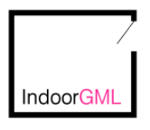
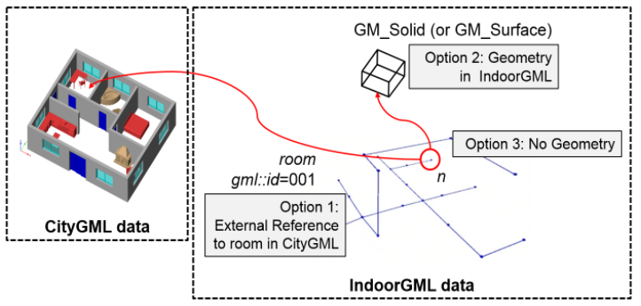
INDOORGML & CESIUM
IndoorGML
&
Cesium
1. IndoorGML
Open Geospatial Consortium (OGC) standard
provides a common framework
Aims to exchange indoor spatial information
provides information to represent movement
Focuses on the relationship between spaces

Slide 7

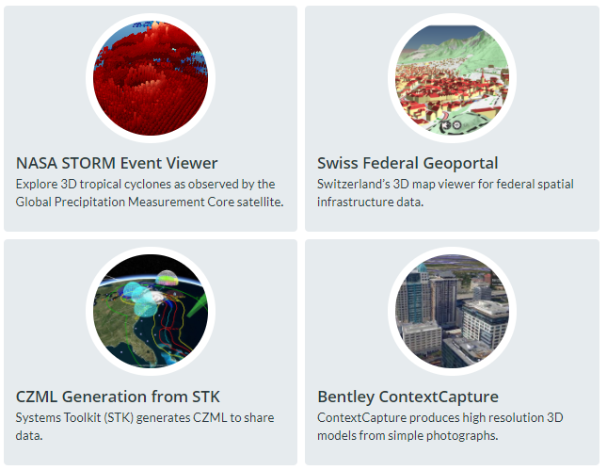
INDOORGML & CESIUM
IndoorGML
&
Cesium
2. Cesium
Open Source
Javascript –based Library
Adapted for 3D applications
Have many public demos and APIs
Still active and updated
Operates as intended

Slide 8
PROJECT DESIGN
PROJECT
DESIGN
IndoorGML
First, IndoorGML data file is converted to a JSON file using jsonix.
GML to JSON data conversion
Second, The converted information is used to draw the building in the chosen viewer along with the network.
JSON
Display Building
Indoor Navigator
Map and network implementation
Camera movement for Indoor Navigator
Third, The camera is controlled to move along the predefined network and rotate around showing the indoor space.
Indoor Viewer

Slide 9


METHOD
METHOD
1. GML to JSON
We need to convert the GML file to JSON
Using JSONIX
JSONIX
JavaScript library
Convert between XML and JSON
Simple usage

Slide 10
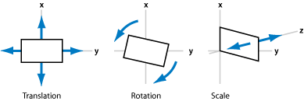
METHOD
METHOD
2. Map and network implementation
surfaceMember
coordinates
cellSpaceMember

Slide 11
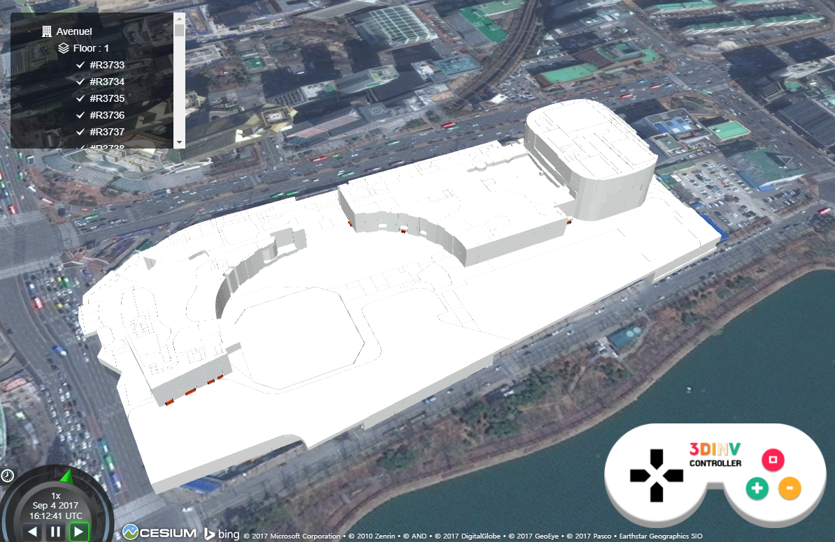
METHOD
METHOD
Building of Lotte World Mall located in Seoul, South Korea

Slide 12
METHOD
METHOD
2. Map and network implementation
Space
node
edge
Space Boundary

Slide 13
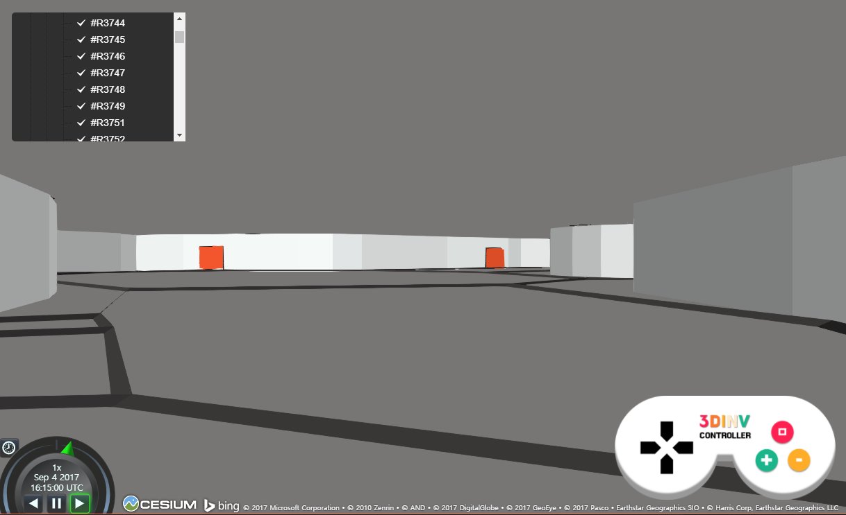
METHOD
METHOD
Network inside Lotte World Mall building located in Seoul, South Korea

Slide 14
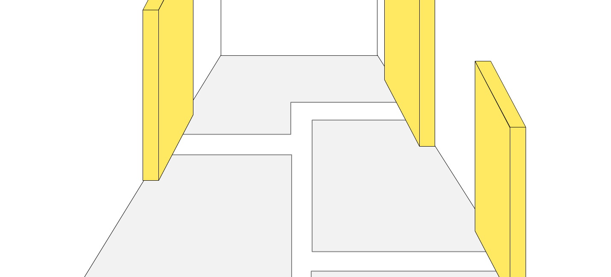

METHOD
METHOD
3. Camera movements for Indoor Navigation
MOVE FORWARD
ZOOM IN
TURN LEFT
TURN RIGHT
MOVE BACKWARD
ZOOM OUT

Slide 15
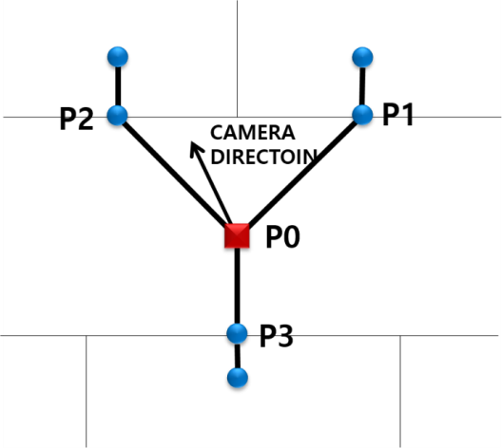
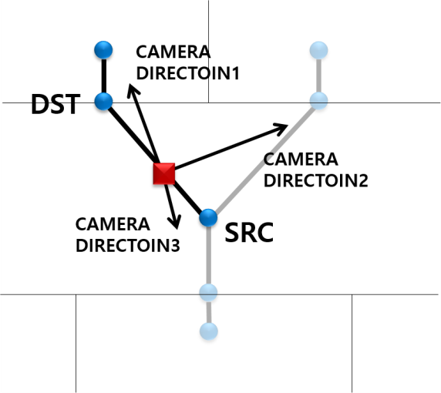
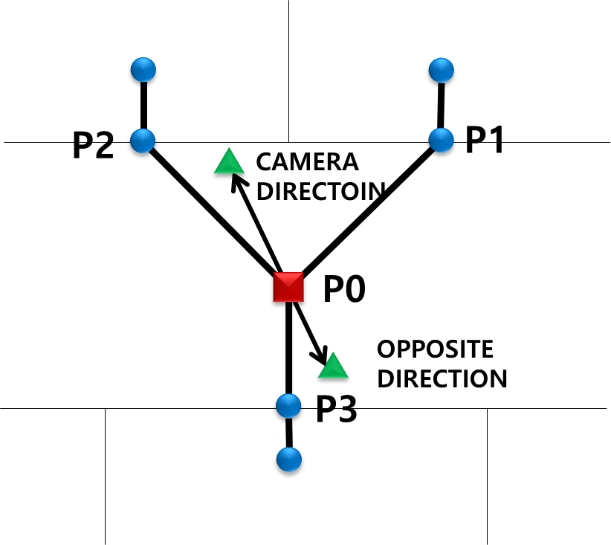
METHOD
METHOD
In order to move camera…
First, find the edge which camera will move.
In order to move camera…
Second, judge direction which the camera will move.
In case of Move Backward,
set opposite direction and use it as camera direction.

Slide 16
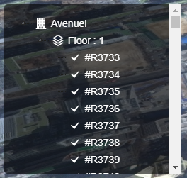
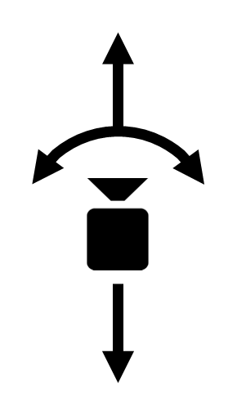
METHOD
METHOD
Lastly, we can move camera using tree view
and zoom in/out as well as rotation.
ZOOM IN
TURN LEFT
TURN RIGHT
ZOOM OUT

Slide 17
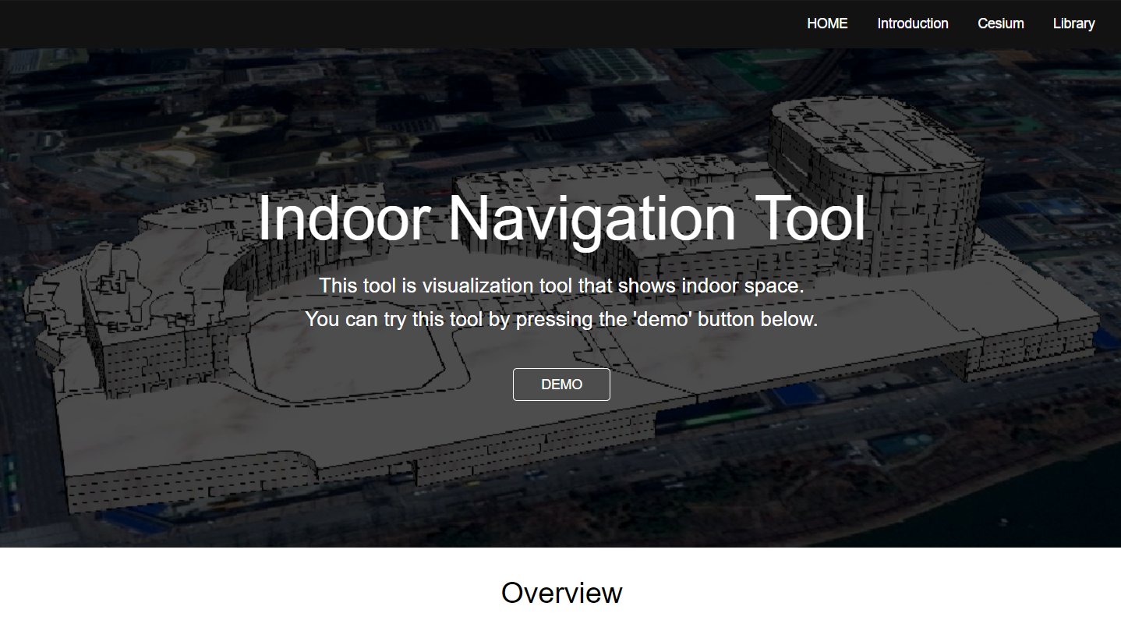


IMPLEMENTATION
IMPLEMENTATION
3. Website application for indoor viewer
The software platform used server-side development
Written in the javascript language
Use the open source library called ‘npm’
Cloud Platform as a Service (PaaS)
Web application deployment model
Easy to use and Provide free service

Slide 18
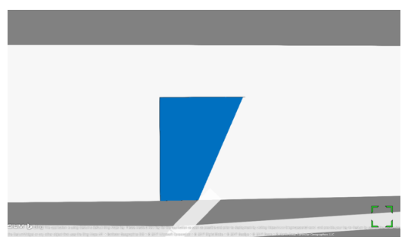
FUTURE RESEARCH PLAN
FUTURE RESEARCH PLAN
1. z-fighting caused by overlapping polygons
2. Lack of information in data sample

Slide 19
DEMO

Slide 20
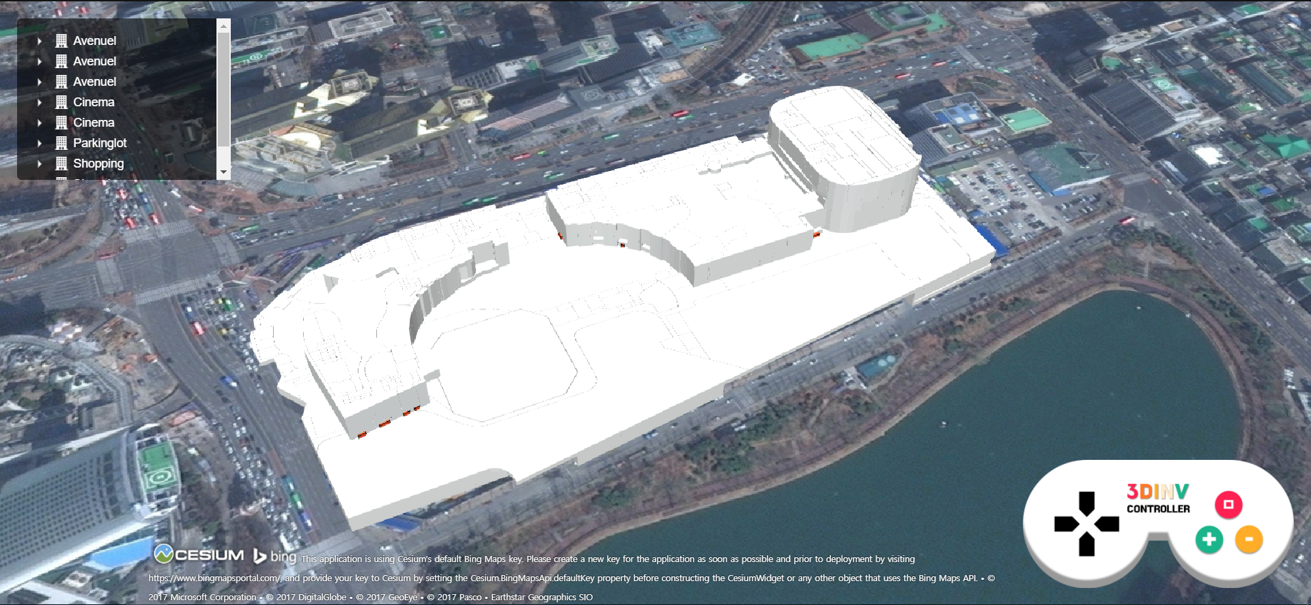
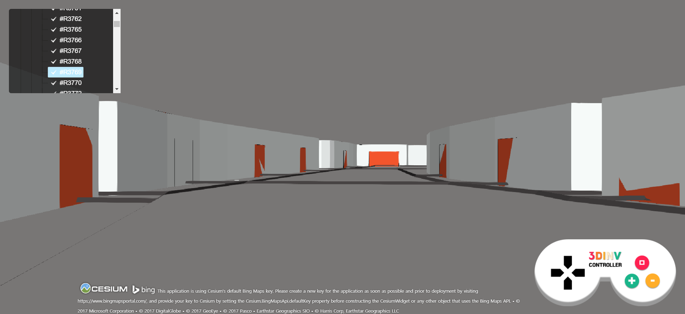
CONCLUSION
Conclusion
This indoor viewer was created thanks to
Cesium
& Network information of IndoorGML

Slide 21
Q&A
THANK YOU FOR LISTENING

